Slide 1
Capstone Design
Team 3
20163704
20161344
20164245
Park JuHyeon
Heo JeongWoo
Hong Jin

Slide 2
Contents
1.
Feedback
Progress
Schedule
Q&A
2.
3.
4.

Slide 3
1.
Q&A Feedback

Slide 4
2.
Progress

Slide 5
2.1
UI

Slide 6
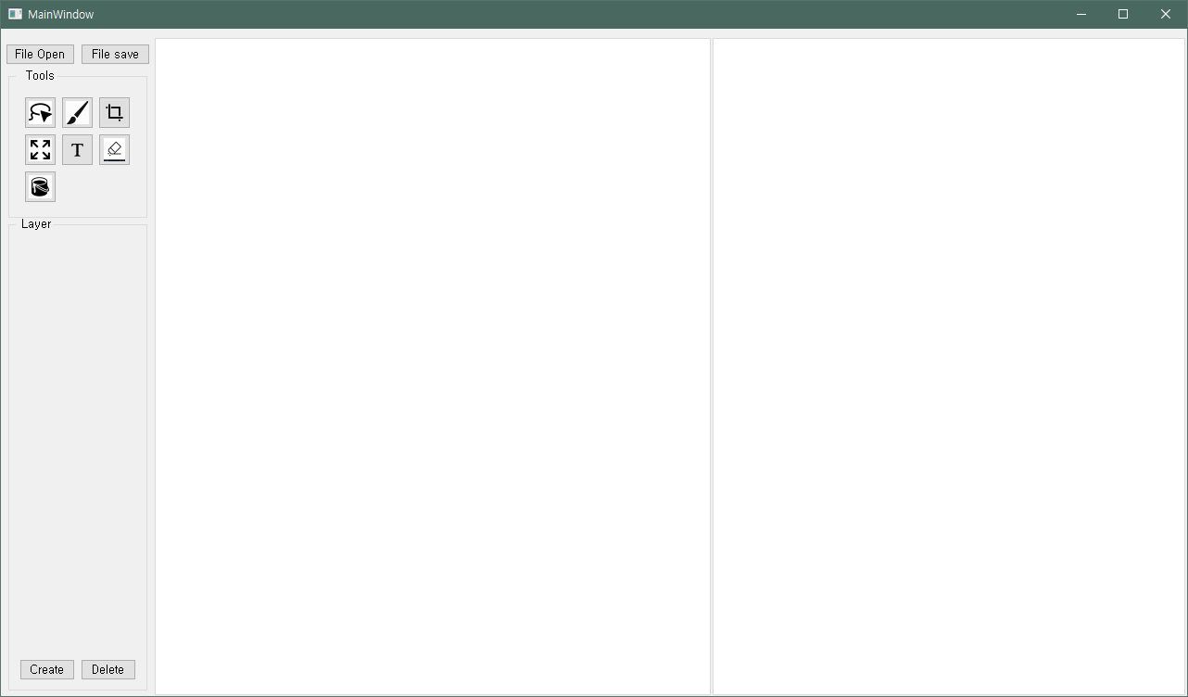
2
Progress
UI – Heo Jeongwoo & Hong Jin
Simple UI

Slide 7
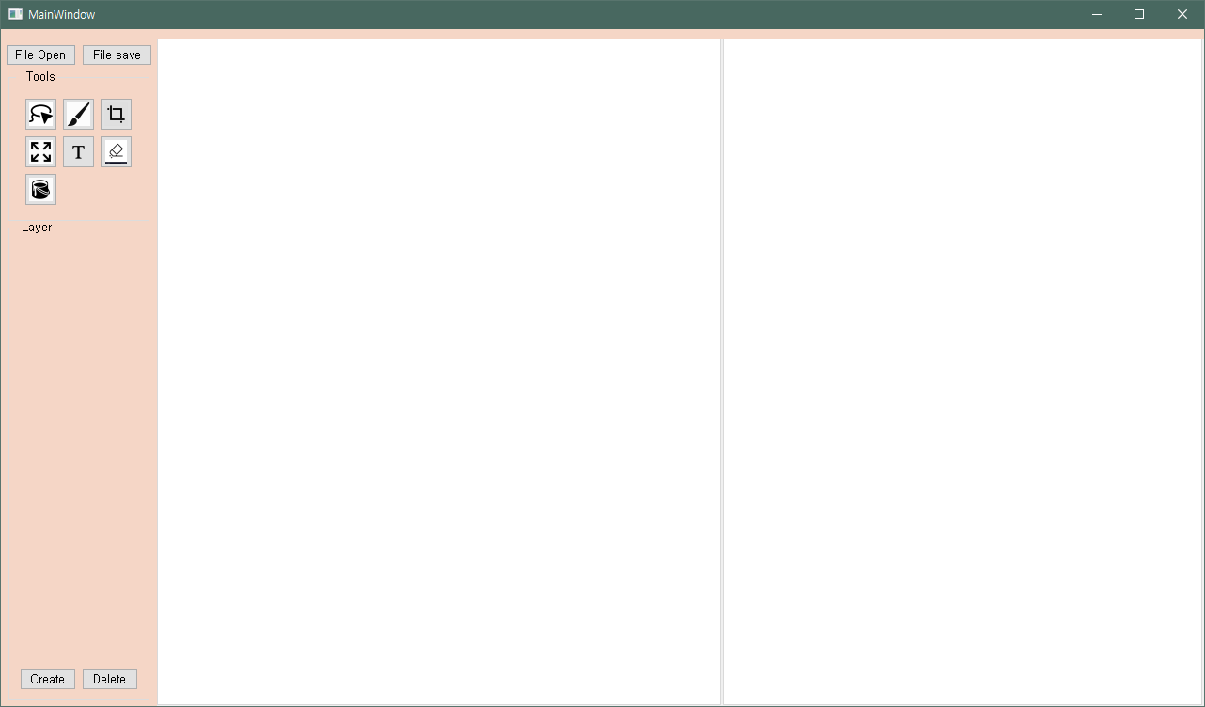
2
Progress
UI - Heo Jeongwoo & Hong Jin
Apply CSS Code
background-color:#F5D6C6;

Slide 8
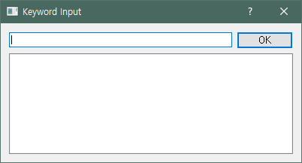
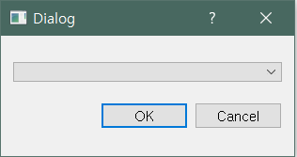
2
Progress
UI - Heo Jeongwoo & Hong Jin
Lasso Tool

Slide 9
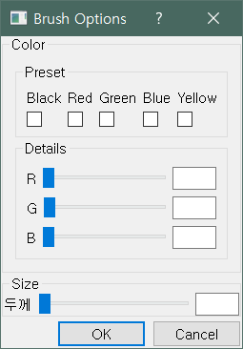
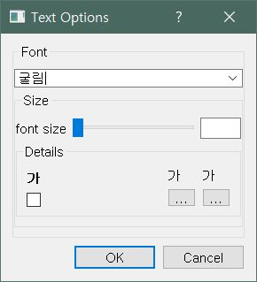
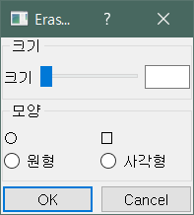
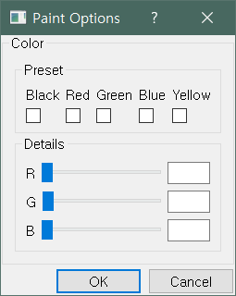
2
Progress
UI - Heo Jeongwoo & Hong Jin
Bursh tool
Text tool
Eraser tool
Paint tool

Slide 10
2
Progress
Basic Functions – Heo Jeongwoo & Hong Jin
File Open

Slide 11
2.2
Image Segmentation

Slide 12
2
Progress
Image Segmentation – Park Juhyeon
t

Slide 13
3.
Schedule

Slide 14
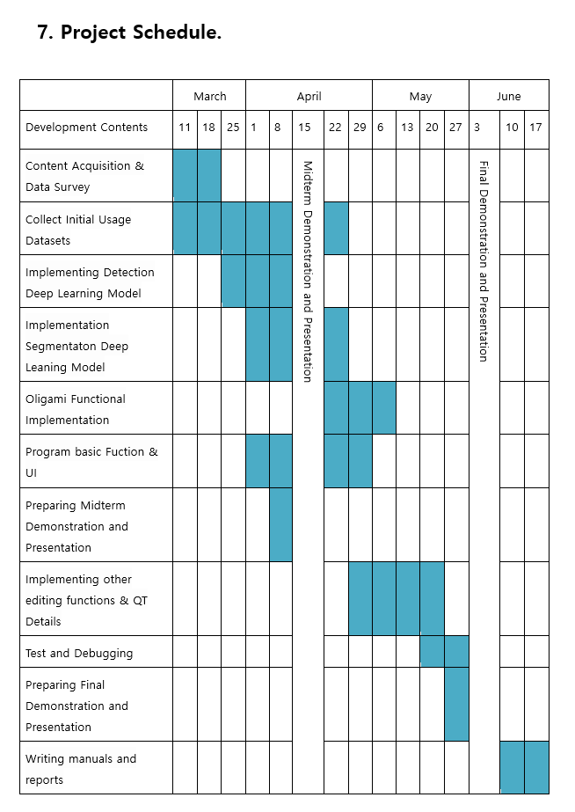
3
Total Schedule

Slide 15
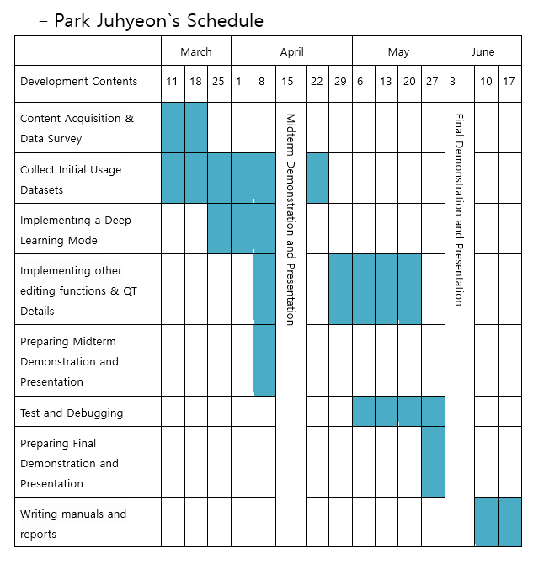
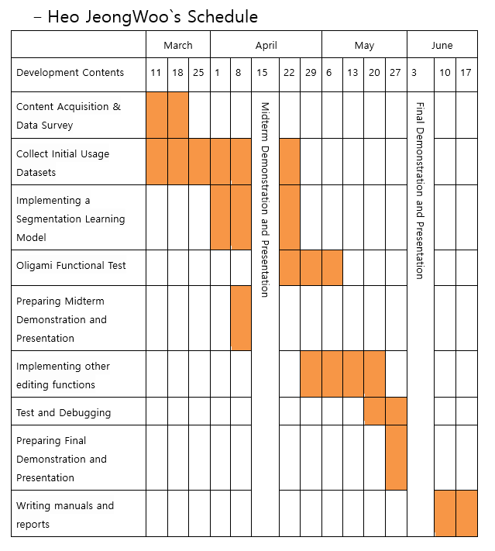
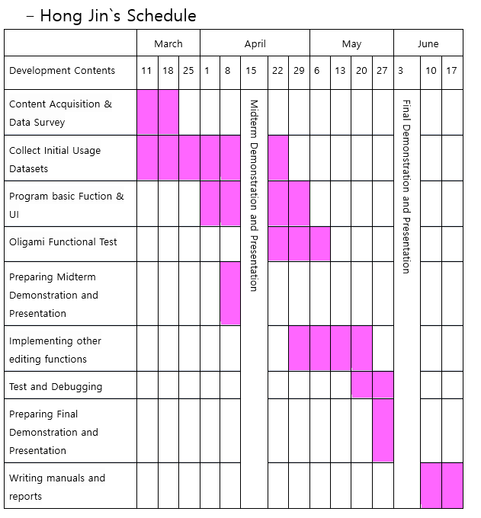
3
Schedule

Slide 16
4.
Q&A

